Slide 1


Indian Sign Language Detection
By Anurag Singh – 3609
Soham Singh – 3615
Shashank Kumar – 3626

Slide 2
INTRODUCTION
Sign language is the medium of communication for the hearing impaired people. It uses gestures instead of sound to convey meaning which combine hand gesture, body language, etc. It is not universal and just like spoken language, it has regional dialects.
In India, over 2 million people are deaf. They find it difficult to communicate with the normal people as the hearing or normal people are unfamiliar of sign language. There arises the need for sign language interpreters who can translate sign language to spoken language and vice versa. But, the availability of such interpreters is limited and expensive. This resulted in the development of automatic sign language recognition systems which could automatically translate the signs into corresponding text or voice without the help of sign language interpreters. Such systems can help in the development of deaf community through human computer interaction.
Sign language recognition is an important research area since there are a lot of challenges in developing an automatic recognition system. Most of the researchers in this area concentrate on the recognition of American Sign Language (ASL) since most of the signs in ASL are single handed and thus, complexity is less. Another attractive feature is that ASL already has a standard database that is available for use. When compared with ASL, Indian Sign Language (ISL) relies on both hands and thus, an ISL recognition system is more complex. The research works carried out by the researchers in the recognition of ISL is very less.

Slide 3
OBJECTIVE AND SCOPE OF THE PROJECT
The Objective of Indian sign language recognition system is to provide an efficient and accurate system to convert sign language into text so that communication between deaf and normal people can be more convenient. Because Most of the people cannot communicate with any Deaf person and they do not have any understanding of Sign language everyone knows about sign language but no one actually puts any efforts to learn it.
By this project we are trying to solve this problem and create an application where any deaf or dumb person can communicate via hand gestures.
SCOPE
Indian Sign Language designed for Indian deaf and dumb community.
The system understands all Signs of English letters from A - Z.
The system also understands some sign gestures such as hello, bye, thank you etc.
Translates signs and gestures in real time.

Slide 4
THEORETICAL BACKGROUND
Image Acquisition - The image acquisition of signer, i.e. the person conveying in the sign language, can be obtained by using a camera.
Pre-processing - A pre-processing step is carried out on the training images to extract the region of interest (ROI). The ROI can be hands if only hand gestures are considered or both face and hands if the facial gestures are also included. Usually the pre-processing step consists of filtering, image enhancement, image resizing, segmentation and morphological filtering. Filtering and image enhancement can be any one of the commonly used methods. For segmentation, the algorithm that better suits the input video/images has to be selected.
Feature Extraction - Features are the crucial elements for sign language recognition. Feature extraction reduces the computational time without sacrificing the accuracy. Large number of features, such as, hand shape, hand orientation, textures, contour, motion, distance, centre of gravity etc. can be used for sign language recognition. Signs can be recognized using geometric features, like, hand contour, fingertips, finger detections.

Slide 5
Classifier - A classifier is needed in sign language recognition to classify the input signs into different classes. The feature vector obtained from the training database is used to train the classifier during the training phase. When a test input is given, the trained classifier identifies the class corresponding to the sign and displays the text or plays the sound. The test inputs can be images or videos.
Neural Network - An artificial neural network involves a network of simple processing elements (artificial neurons) which can exhibit complex global behaviour, determined by the connections between the processing elements and element parameters. It consists of an interconnected group of artificial neurons and processes information using a connectionist approach to computation. In most cases an ANN is an adaptive system that changes its structure based on external or internal information that flows through the network during the learning phase.

Slide 6
PROBLEM DEFINITION
Imagine a world where anyone can communicate using sign language over video. Inspired by this vision, we aim to build an AI-powered Indian Sign Language (ISL) Translator, to enable easier communication between the DHH and hearing communication in the workplace.
PEOPLE with disabilities or differently able are often isolated from accessing proper health, education and other social interactions Assistive technology can change the life of a differently able person to a great extent in all means.
Deafness and vocal impairment are one of the major disabilities faced by human beings from centuries The DHH community faces the largest challenges at the workplace, with 56% of our survey participants reporting difficulties in communicating with office colleagues. Workplace difficulties rank higher than any other situation - such as banks, while shopping, at restaurants, with family, etc.
Therefore, building an AI-powered translator, it will allow the DHH community to continue conversing in ISL and enables the hearing community to understand them easily.

Slide 7
SOFTWARE REQUIREMENT SPECIFICATION (SRS)
Creating the dataset for sign language detection:
It is fairly possible to get the dataset we need on the internet but in this project, we will be creating the dataset on our own. We will be having a live feed from the video cam and every frame that detects a hand in the ROI (region of interest).
Training CNN:
Now on the created data set we train a CNN. First, we load the data using ImageDataGenerator of keras through which we can use the flow_from_directory function to load the train and test set data, and each of the names of the number folders will be the class names for the imgs loaded.
Predict the gesture
In this, we create a bounding box for detecting the ROI and calculate the accumulated_avg as we did in creating the dataset. This is done for identifying any foreground object. Now we find the max contour and if contour is detected that means a hand is detected so the threshold of the ROI is treated as a test image.

Slide 8
FEASIBILITY STUDY
A feasibility study is used to determine the viability of an idea, such as ensuring a project is legally and technically feasible as well as economically justifiable. It tells us whether a project is worth in the investment-in some cases, a project may not be feasible. To evaluate feasibility, a feasibility study is performed, which determines whether the solution considered to accomplish the requirements is practical and workable in the software. Information such as resource availability, cost estimation for software development, benefits of the software to the organization after it is developed and cost to be incurred on its maintenance are considered during the feasibility study.
The main objective of the feasibility study is to test the Technical ,Operational And Economical Feasibility.
1. Technical Feasibility : The Technical Feasibility study basically centres on alternative for hardware, software and design approach to determine the functional aspects of system.
2. Operational Feasibility : The Operation Feasibility is measure of how people are able to work with system. This type of Feasibility demands if the system will work when developed and installed. Operational feasibility cover two aspect.one is technical performance and the other is acceptance by users. The system is operationally feasible as it is very interective and user friendly.
* User support - User will make hand gestures of letters from A- Z. It will help in the time saving and fast processing of word conversion in real time.
3. Economic Feasibility : The tools that will be used for this system are the latest one and thus the cost involved in tools, designing and developing the system will be a good investment for the organisation.

Slide 9
DETAIL OF HARDWARE AND SOFTWARE USED
Software used :
1. Operating system: Window 10 Home/Mac OS
2. Platform : Jupyter notebook
3. Languages: a.Python :- 1)For Building AI model.
Libraries:
Keras
Numpy
Tensorflow
Pandas
Matplotlib
Hardware used : Intel core i5 8 generation/M1 processor, 1 TB Hard Disk/256 GB SSD, 8 GB DDR4 RAM and Laptop & Desktop

Slide 10
System Analysis and Design
We used Incremental Modal for developing our project.
The incremental build model is a method of software development where the model is designed, implemented and tested incrementally (a little more is added each time) until the product is finished. It involves both development and maintenance. The product is defined as finished when it satisfies all of its requirements. This model combines the elements of the waterfall model with the iterative philosophy of prototyping.
Advantage of Incremental Modal:-
Generates working software quickly and early during the software life cycle.
More flexible – less costly to change scope and requirements.
Easier to test and debug during a smaller iteration.
Easier to manage risk because risky pieces are identified and handled during its iteration.

Slide 11
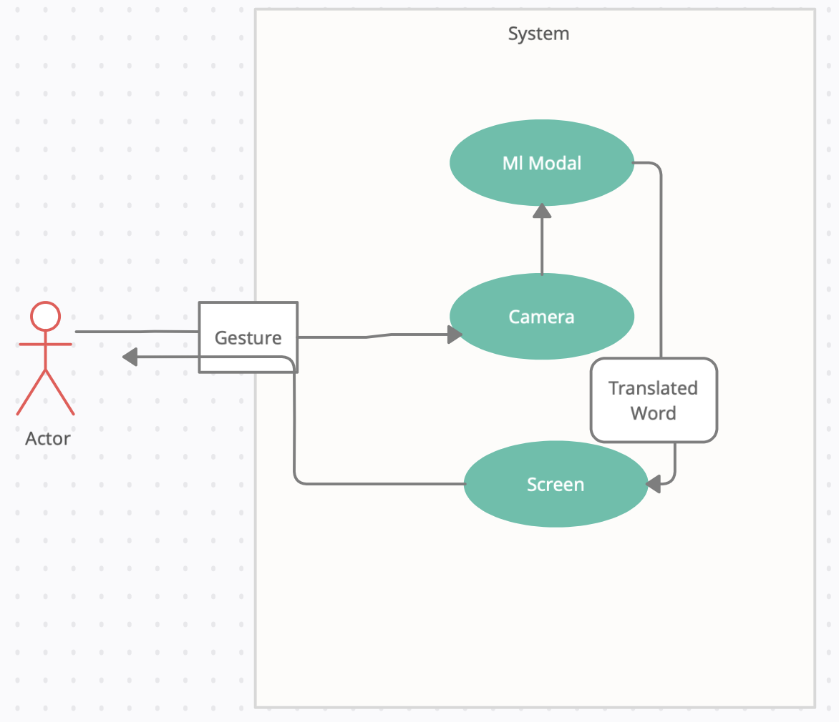
USE CASE DIAGRAM
A use case diagram at its simplest is a representation of a user’s interaction with the system and depicting the specification of a use case. It can portray the different types of users of a system and the various ways that they interact with the system. This type of diagram is typically used in conjunction with the textual use case and will often be accompanied by other types of diagram as well.

Slide 12
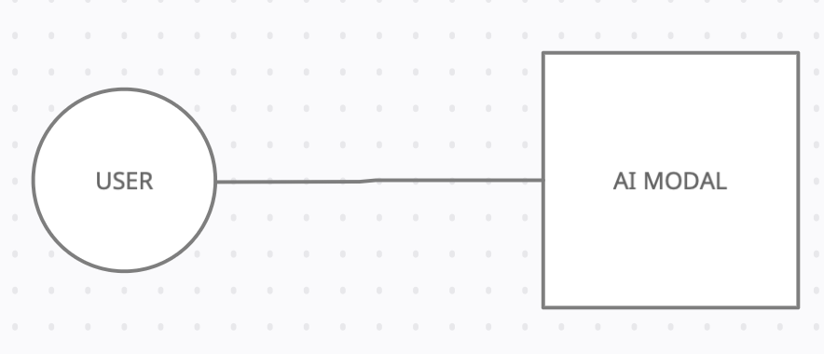
COMPONENT DIAGRAM:
The component diagram mainly consists of database, user Interface and component and shows the relationship between them.

Slide 13
SYSTEM PLANNING:-
GANTT CHART:
GANTT CHART is a graphical representation of a scheduled that helped to plan, coordinates and track specific task on a project. is one of the most popular and useful ways of showing activities (tasks or events) displayed against time. On the left of the chart is a list of the activities and along the top is a suitable time scale. Each activity is represented by a bar; the position and length of the bar reflects the start date, duration and end date of the activity. This allows you to see at a glance:
What the various activities are.
Where activities overlap with other activities, and by how much.
How long each activity is scheduled to last.
When each activity begins and ends.
The start and end date of the whole project.

Slide 14
System testing
In system testing the behaviour of whole system/product is tested as defined by the scope of the development project or product which may include tests based on risks and/or requirement specifications, business process, use cases, or other high level descriptions of system behaviour, interactions with the operating systems, and system resources.
System testing is most often the final test to verify that the system to be delivered meets the specification and its purpose. It is carried out by specialists testers or independent testers. System testing should investigate both functional and non-functional requirements of the testing.

Slide 15
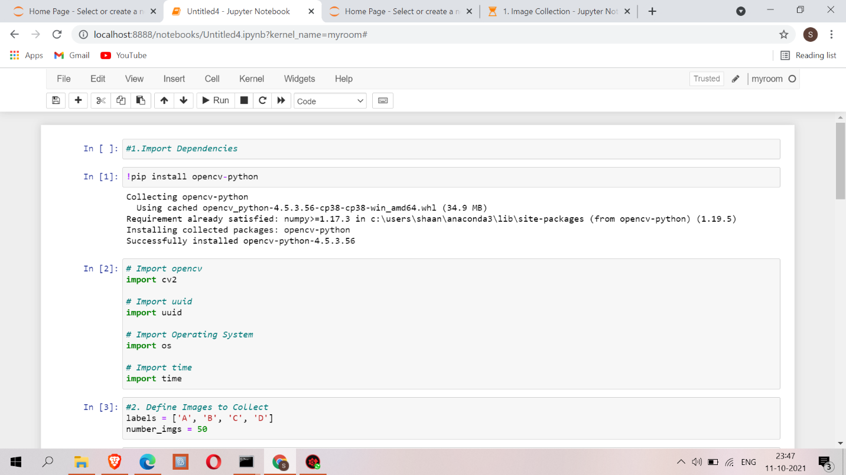
IMPLEMENTATION:-

Slide 16
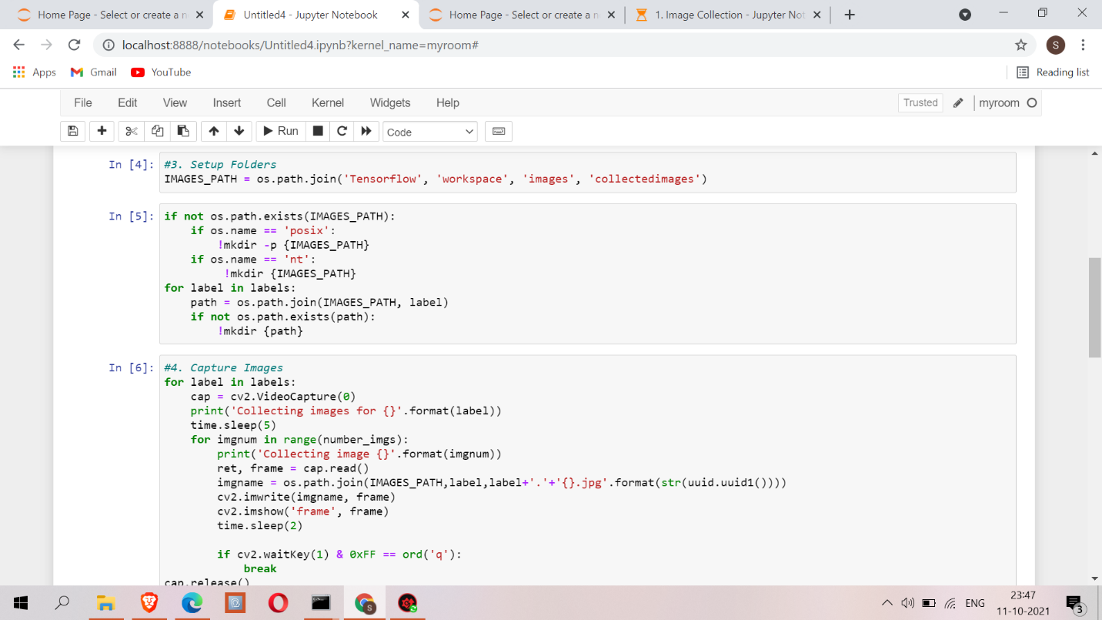

Slide 17
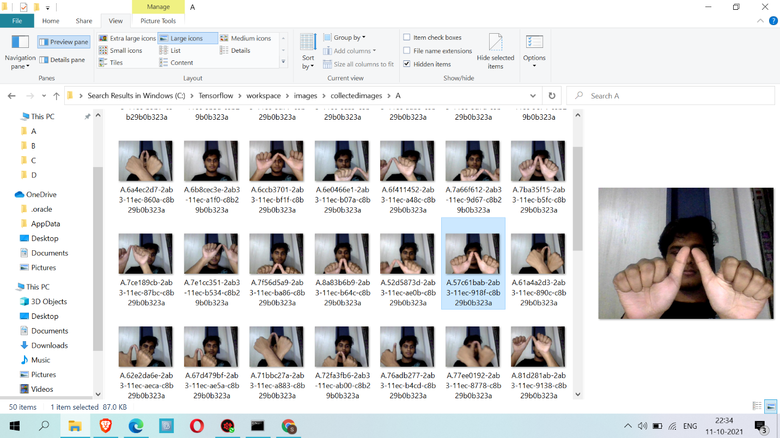
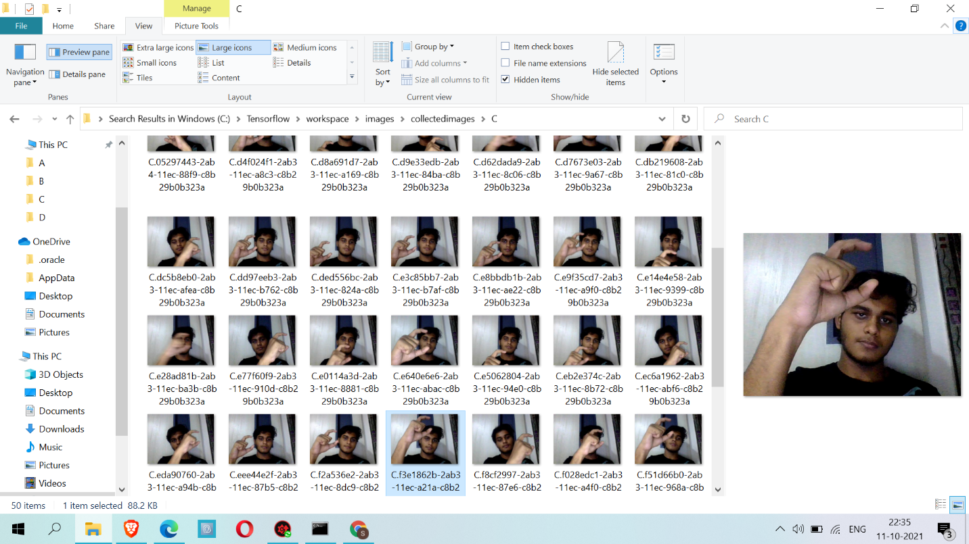
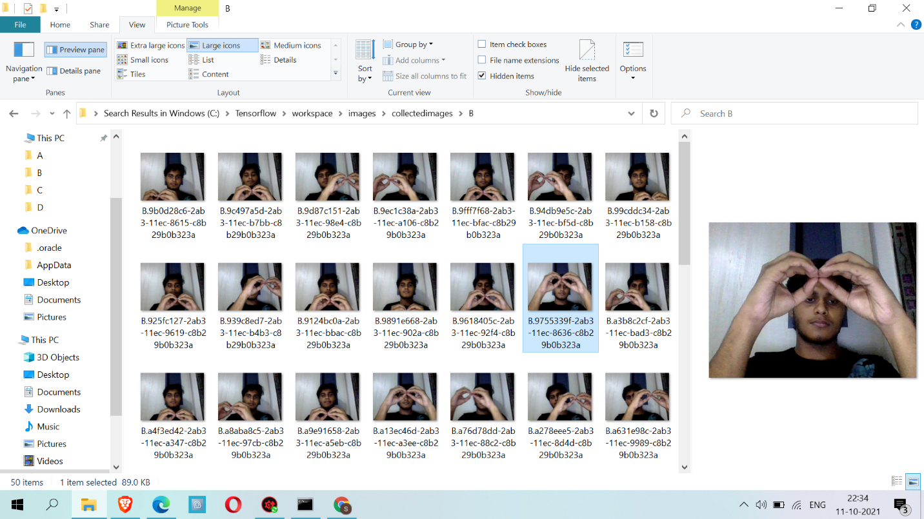
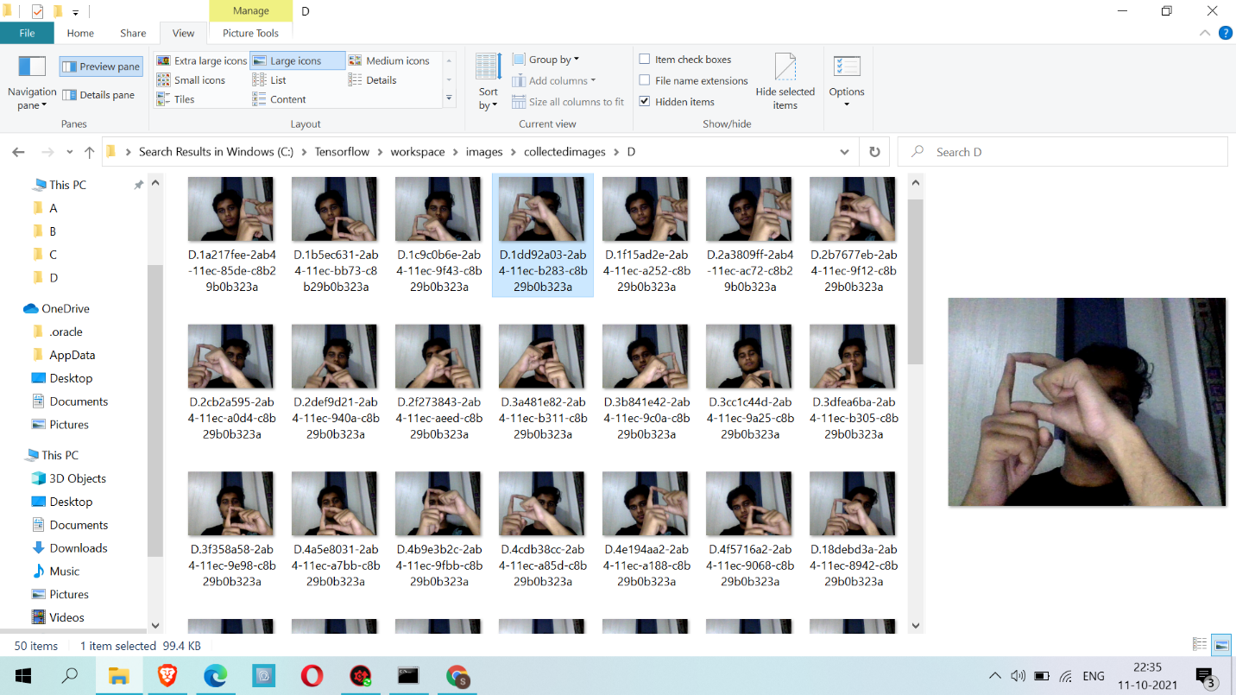

Slide 18
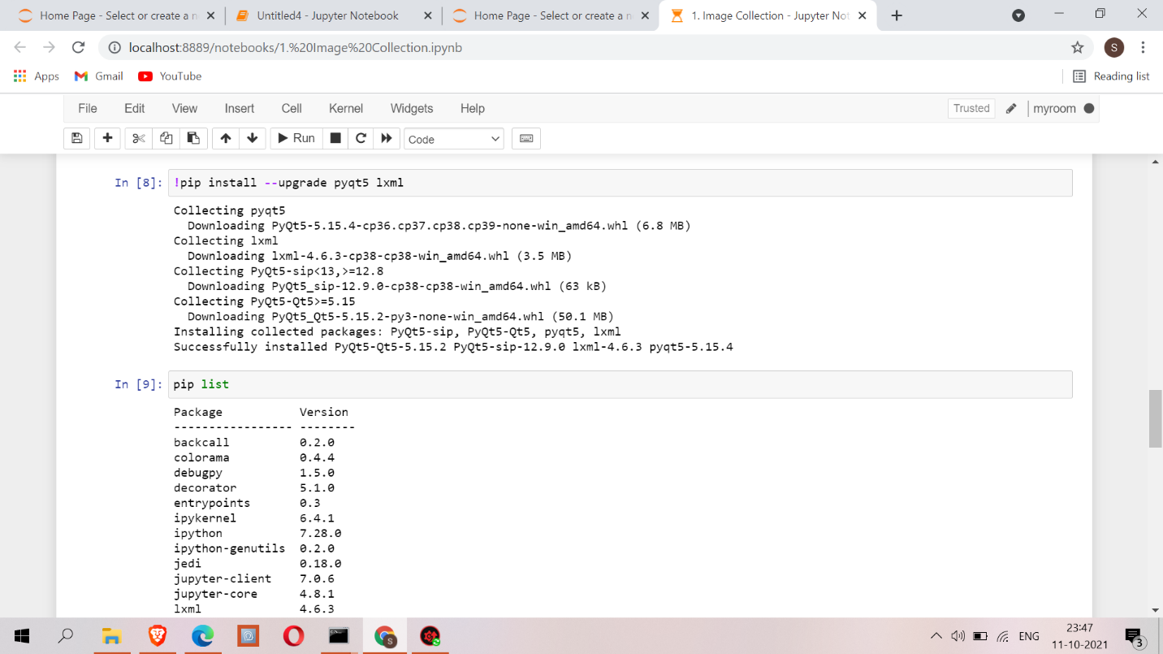

Slide 19
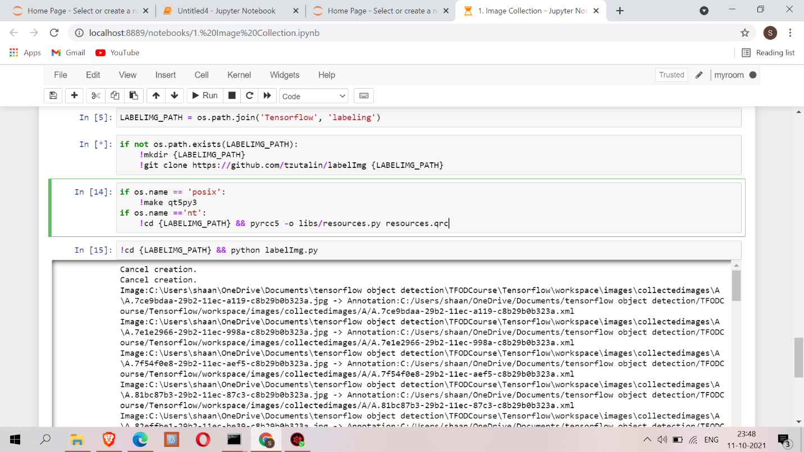

Slide 20
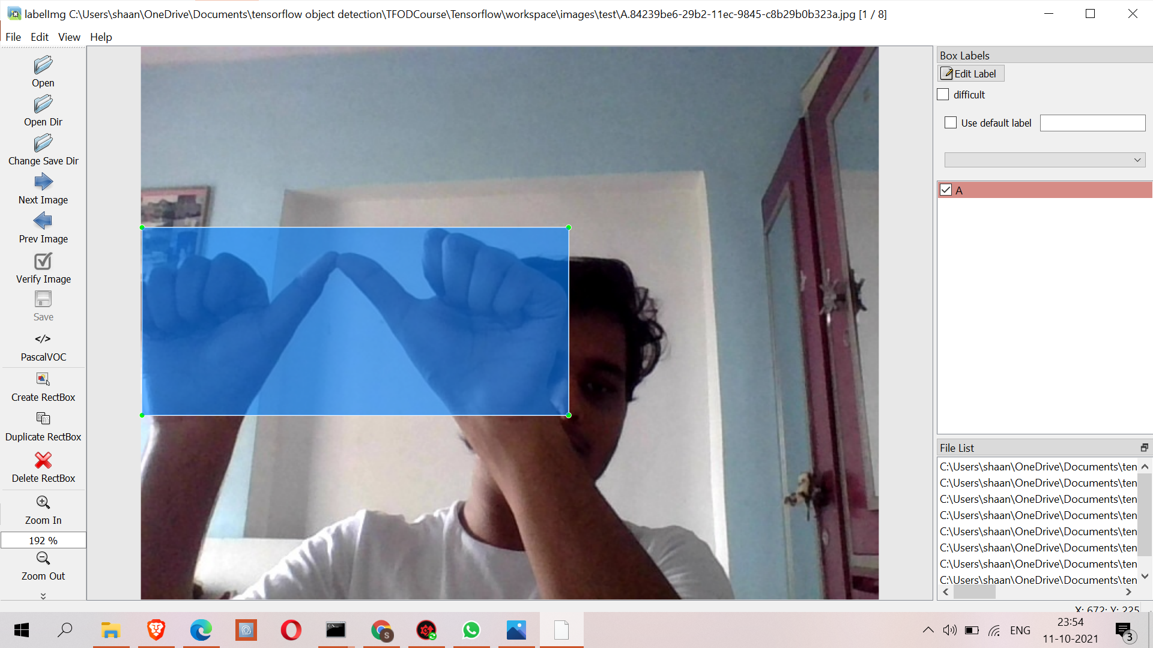
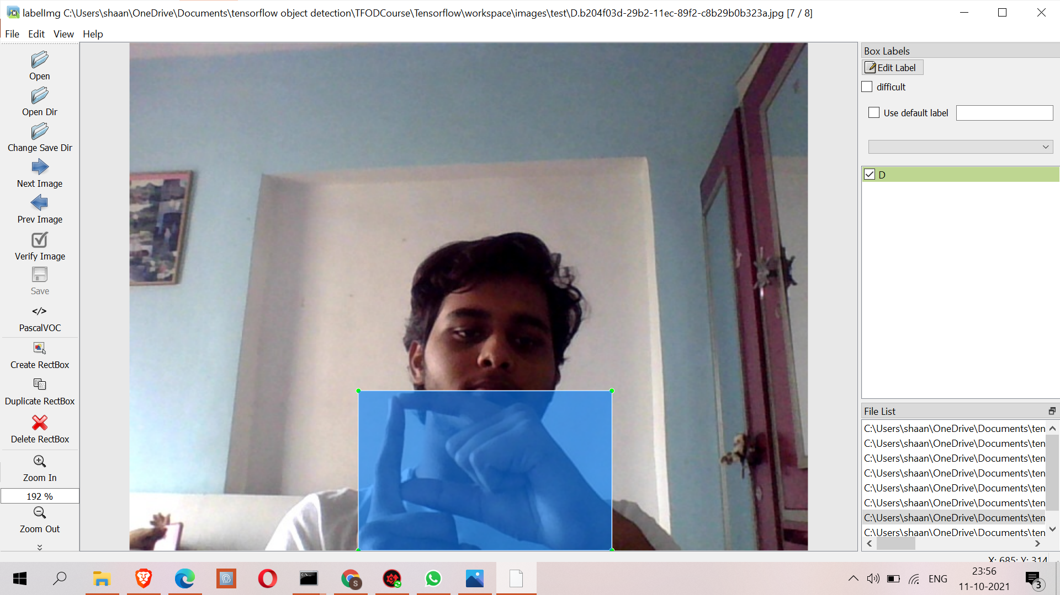
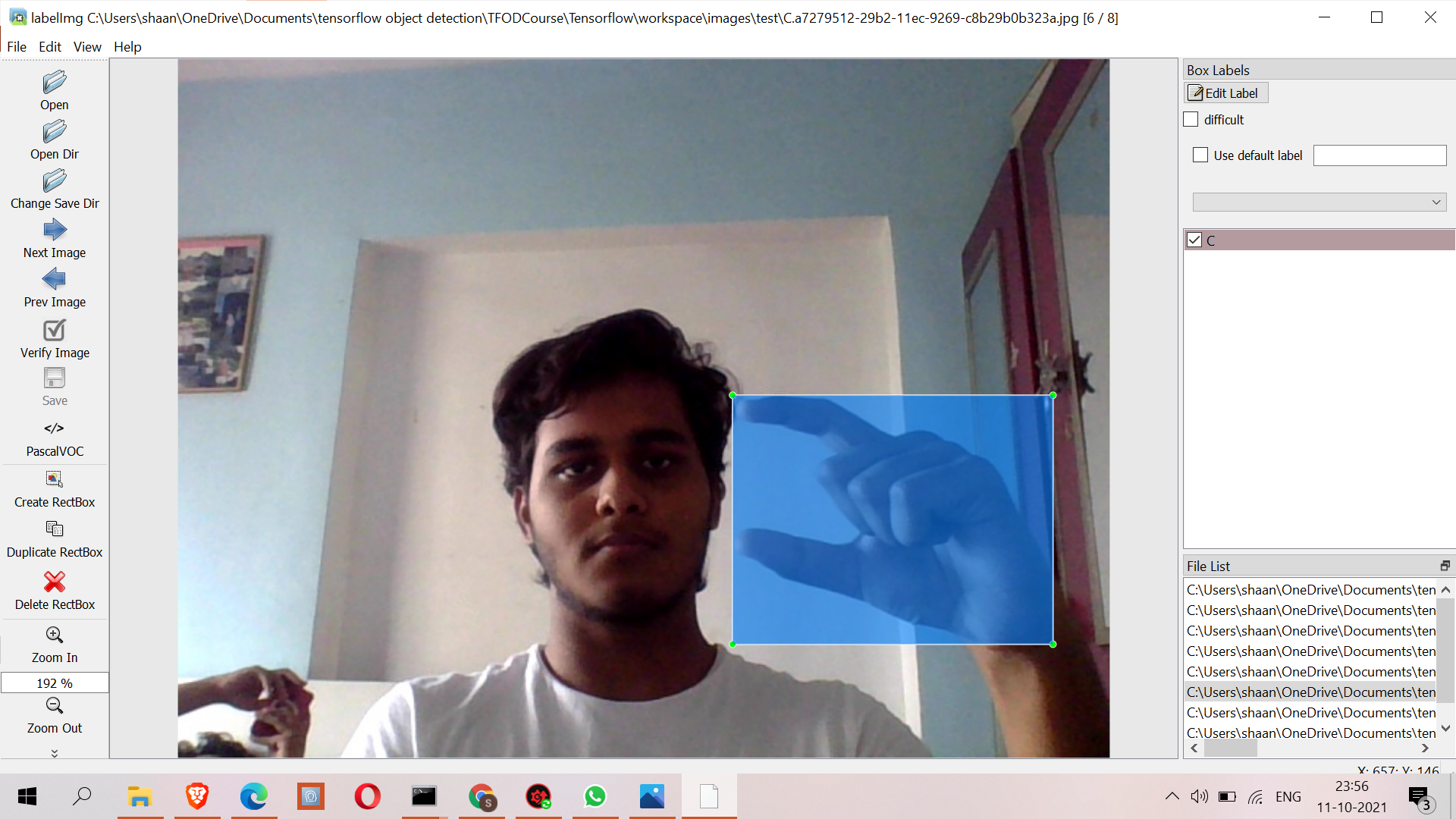

Slide 21
FUTURE WORK
Software technology advancements are occurring at a rapid pace. This has compelled designers and developers to seek out new approaches to design and development. To deal with this situation, the modules in a package should be updated at any time. The modules included in this package can be improved further. As an example:
We integrate this project with Django
Will be making a full pleged video chat application that has the ability to generate sign or gesture to text in real time
Addition a functionality where user can train their own gesture by capturing the image and typing what that image means
If possible we will be deploying this application on any cloud such as Heroku or Aws or Hostlinger

Slide 22
REFERENCES
1) Noor Adnan Ibraheem, RafiqulZaman Khan, 2012, Survey on Various Gesture Recognition Technologies and Techniques, International Journal of Computer Applications, Volume 50, No. 7
2) P.V.V Kishore, P. Rajesh Kumar, E. Kiran Kumar & S.R.C.Kishore, 2011, Video Audio Interface for Recognizing Gestures of Indian Sign Language, International Journal of Image Processing (IJIP), Volume 5, Issue 4, 2011 pp. 479-503
3) P.V.V.Kishore, P.Rajesh Kumar, 2012, A Model For Real Time Sign Language Recognition System, International Journal of Advanced Research in Computer Science and Software Engineering Volume 2, Issue 6, June 2012 pp. 30-35

Slide 23
Thank you!

